Slide 1
Weighted bootstrapping making more use of more recent data
OCTOBER 2026

Slide 2
INPUTS INTO SCENARIO GENERATION
We’ve now covered Monte Carlo simulation and simple boot-strapping.
We randomly selected several short periods from history and combined them to generate scenarios of our desired length.
The short periods we choose are just as likely to come from the recent past as from long ago. Is that a good thing?
There’s a never-ending trade-off between going back in time to get as much data as you can, and the fact that the world may have changed since then.

Slide 3
Dealing with change
Asset monthly returns
Consider the monthly returns of this asset.
It looks as if something might have fundamentally changed about seven months ago.
If so, do we really want to use data older than this? Should we throw it away?
Time-weighting is a way of still using all the data, but attaching greater importance to that which is more recent.
<- Back in time

Slide 4
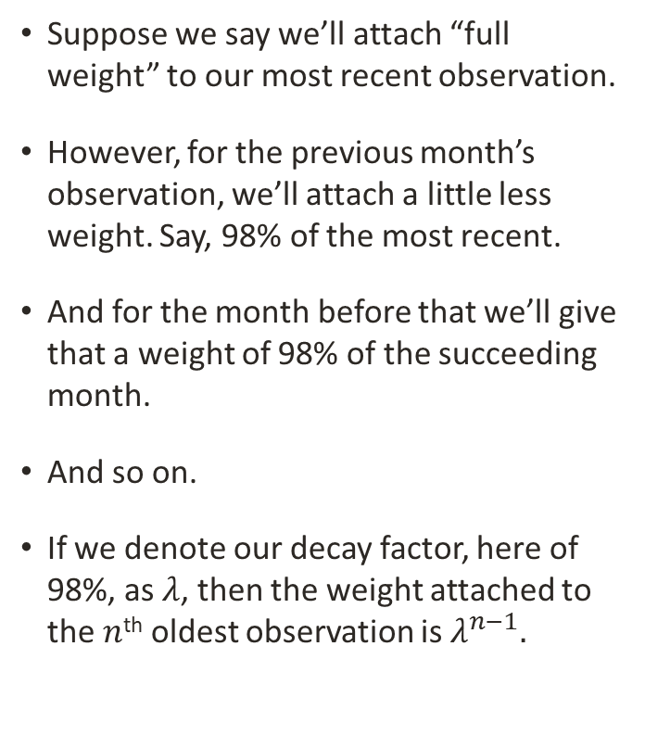
Exponential weighting
Weighting factors of historical observations
Suppose we say we’ll attach “full weight” to our most recent observation.
However, for the previous month’s observation, we’ll attach a little less weight. Say, 98% of the most recent.
And for the month before that we’ll give that a weight of 98% of the succeeding month.
And so on.
If we denote our decay factor, here of 98%, as $λ$, then the weight attached to the $n$^{th} oldest observation is $λ^{n−1}.$
<- Back in time

Slide 5
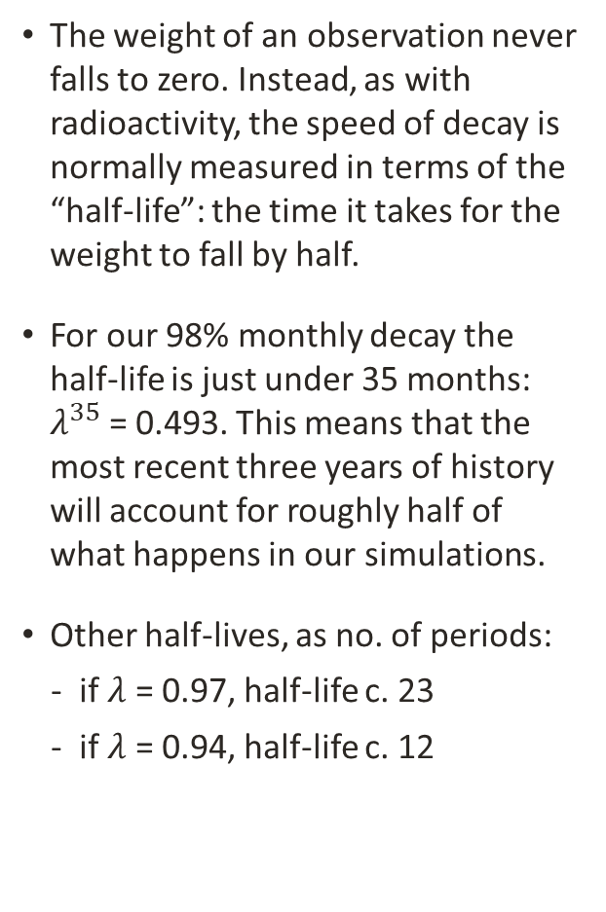
Half-lives
Combining returns and weighting factors
The weight of an observation never falls to zero. Instead, as with radioactivity, the speed of decay is normally measured in terms of the “half-life”: the time it takes for the weight to fall by half.
For our 98% monthly decay the half-life is just under 35 months: $λ^{35}$ = 0.493. This means that the most recent three years of history will account for roughly half of what happens in our simulations.
Other half-lives, as no. of periods:
  if $λ$ = 0.97, half-life c. 23
  if $λ$ = 0.94, half-life c. 12
<- Back in time

Slide 6
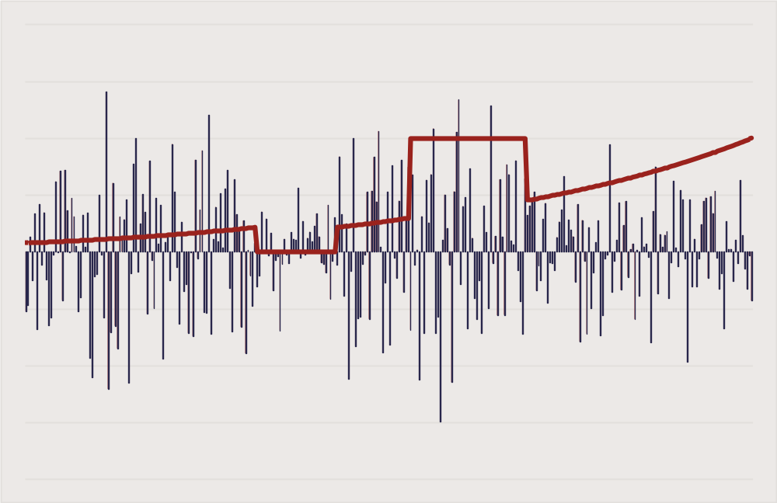
Variations on exponential weighting
Historical returns and example weighting factors
Other weighting schemes are available, and it could be useful to mix schemes.
For example, it could be that a historical period of heightened volatility is of concern, so you give it a full weight.
Another period that is unlikely to recur could be given a zero weight to exclude it from your scenarios.
<- Back in time
Is it better to optimise over a single set of scenarios with different weights like this, or is it better to split the scenarios into different sets and – for example – come up with a portfolio that does well in one “most likely” set, but doesn’t blow up if another set turns out be closer to reality?

Slide 7
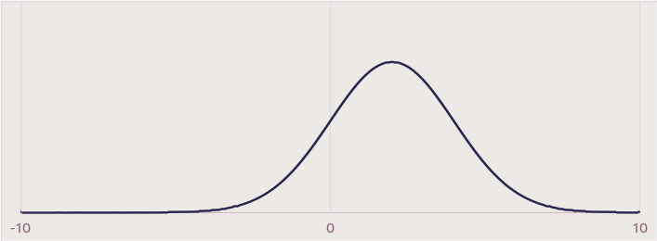
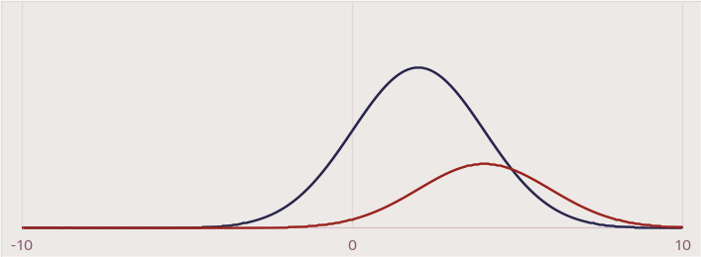
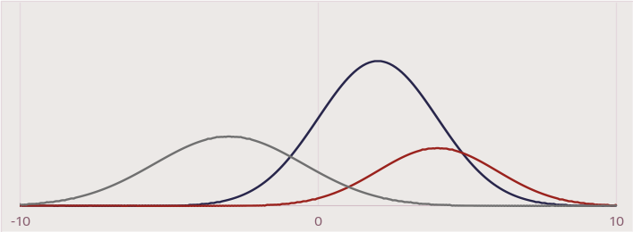
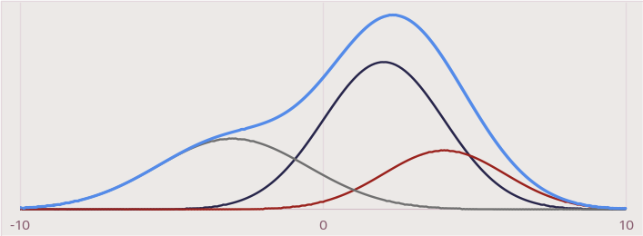
USING MULTIPLE SCENARIOS – example
Scenario asset return distributions,
weighted by likelihood
To generate robust portfolios
Suppose that over the next few months you think the market is most likely to behave pretty well, and you think the chance of this is 50%.
But if things go well maybe there’s a chance you’re being too pessimistic, and the market could do even better. You feel the chance of this is 20%.
Alternatively, some things may happen in the world which drive the market downwards. The chance of this is the remaining 30%.
Combining simulations from all three scenarios - in proportion to their chances - and using them to come up with a robust portfolio, is a perfectly valid way of making good use of your views.

Slide 8


An alternative approach
Focus on doing well in the primary scenario, but limit losses in the others
Rather than optimising a portfolio across all the simulations from the different scenarios, another approach is to find a portfolio that performs well in your most-likely scenario, but won’t blow up if either of the other scenarios comes about.
Note that, as portrayed, this approach does not make any use of the scenario likelihoods.
The vertical arrows represent example expected returns of one portfolio in each scenario
$$✓$$
$$✓$$
Minimum- performance threshold
Return

Slide 9
Back to TIME-WEIGHTING
When measuring the current risks of our portfolios, we have some choices to make
What is the “right” time-weighting to use? What about daily versus monthly data?
Maybe looking at more than one time-weighting makes sense, but then there’s the risk of being swamped by too much information. Particularly as we shouldn’t look just at tracking error and neglect other risk measures.
And the more stakeholders who trust and use the risk measures, the better.
Would it be better to focus on a simpler risk measure that’s more familiar? Such as? What is the most commonly used risk measure for fixed income portfolios?

Slide 10
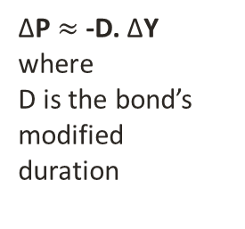
Duration
The instantaneous price-yield relationship
Duration is the sensitivity of a bond or bond portfolio’s value to a change in yield
Here we’re looking at how the price and yield of a bond move together at a single moment in time.
Using duration enables the easy comparison of risks between strategies both today and over time: it is often used by portfolio managers for risk-budgeting purposes.
Maybe we should just use duration and forget all about tracking error?
Yield
Convexity adjustment
Spot Price
Convexity adjustment
ΔP $≈$ -D. ΔY
where
D is the bond’s modified duration
Price

Slide 11
BUT DURATION ALONE IS NOT ENOUGH
Visualising adding the risks of two trades (in grey and blue) to get the risk of a portfolio (in red)
When the trades are closely related
When less closely related
Suppose we have two trades in our portfolio, each with a 3m duration exposure. If the trades are in assets of different volatility their risks in tracking error terms, as signified by the length of the arrows, will be different.
Depending on how closely related the trades are the final tracking error of the portfolio can vary considerably.
If the two trades were independent the portfolio risk could be calculated using Pythagoras’ theorem.

Slide 12






CONSTANT DURATION DOES NOT MEAN CONSTANT RISK
Tracking errors over time for constant 3m exposures in 2y and 10y USTs calculated using different daily time decays
2y UST, $λ$ = 1
2y UST, $λ$ = 0.97
2y UST, $λ$ = 0.94
10y UST, $λ$ = 1
10y UST, $λ$ = 0.97
10y UST, $λ$ = 0.94
Source: CAIM, ICE, October 2026

